Slide 1
AI-Based Medical Image Diagnosis
A computer-aided medical image analysis system using Computer Vision and Deep Learning
Presented by:
P. Harshitha (192312506)
K. Rama Keerthi (192312495)
M. Ayeesha Parveen (192311313)
J. Lokesh ( 192311216)
S. Guruprasath (192411270L)

Slide 2
Introduction
Doctors use X-ray, CT, MRI and ultrasound images to find diseases
Reading thousands of images by eye is slow, tiring and can vary from person to person
Computer vision lets a computer see and measure what is inside an image
Deep learning lets it learn disease patterns from thousands of examples
Aim: build a system that helps doctors read images faster and more accurately

Slide 3
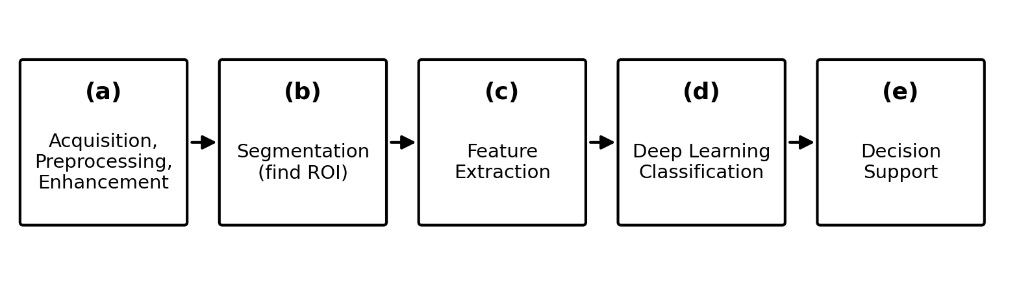
Overall System Pipeline
Five stages from raw scan to doctor's report
Scan goes in, cleaned and enhanced image comes out of stage (a)
Stages (b) and (c) find the problem area and describe it with numbers
Stage (d) decides what the pattern means; stage (e) reports it to the doctor

Slide 4
(a) Image Acquisition and Preprocessing
First, we collect the medical images — like X-rays, CT scans, MRI, or ultrasound.
We store the images in DICOM format and remove patient details to keep their information private.
Next, we make all images the same size so the neural network can process them easily.
We adjust the brightness so images from different scanning machines look more similar.
Finally, we flip, rotate, or crop some images to create more training examples for the AI.

Slide 5
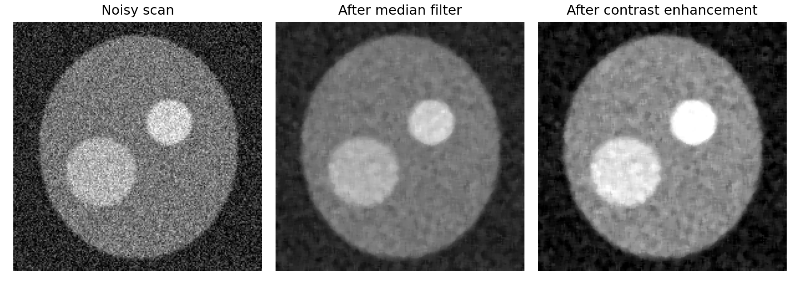
(b) Noise Removal and Enhancement
Example on a synthetic scan
Medical images may contain unwanted noise due to the scanning process. Different scans can have different types of noise.
We use filters like Median, Gaussian, and Bilateral to remove unwanted noise from the images.
Finally, we improve the image contrast using Histogram Equalisation or CLAHE, making important details and edges easier to see.

Slide 6
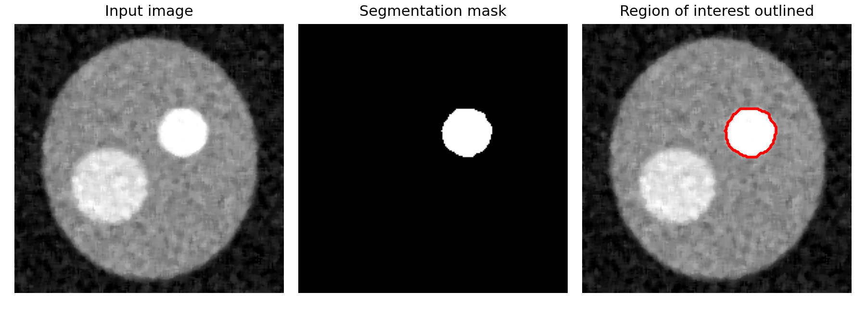
(c) Segmentation of Regions of Interest
Example on a synthetic scan
Segmentation helps separate important areas, such as tumours, lesions, or organs, from the background.
We can use traditional methods like thresholding and region growing, or deep learning models like U-Net, SegNet, and Mask R-CNN to identify these areas.
We measure segmentation accuracy using Dice score and IoU to check how accurately the system identifies the required region.

Slide 7
(d) Feature Detection and Extraction
Converts the selected part of the image into useful information that the computer can understand.
Shape features: Looks at the shape and size, such as the area, boundary, and how regular or irregular it is.
Texture features: Checks the surface pattern of the tissue, such as whether it looks smooth or rough.
Intensity features: Looks at the brightness of the pixels, including their average and how much they vary.
Deep learning: Instead of manually selecting features, deep learning models can automatically learn important features from the image.

Slide 8
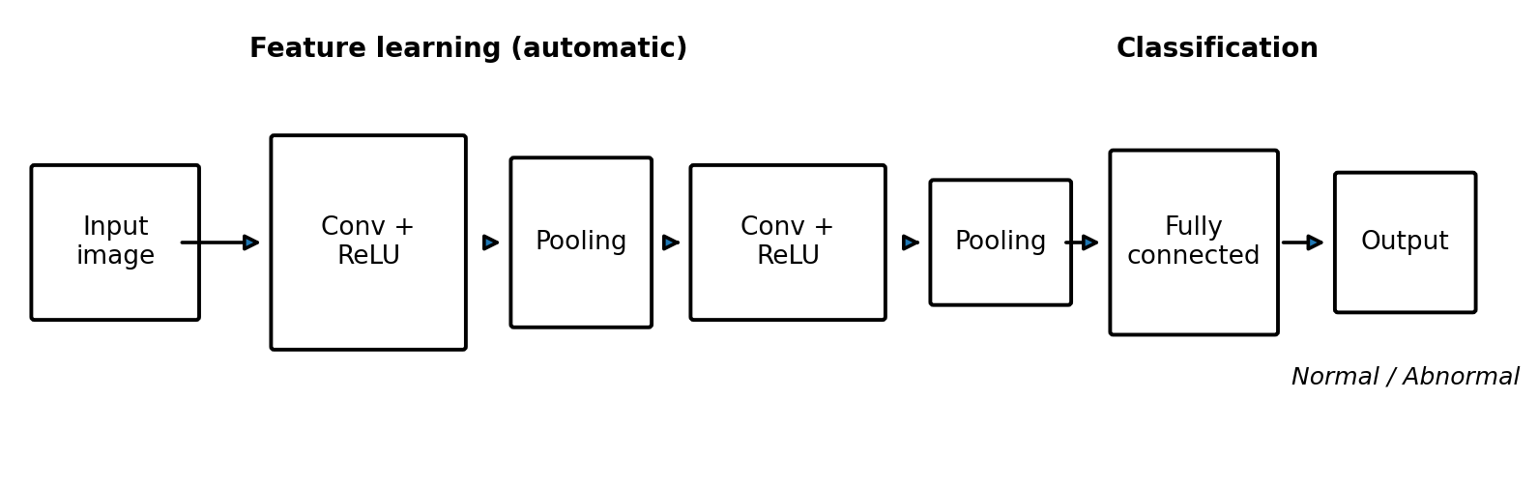
(e) Deep-Learning Classification
Convolutional Neural Network (CNN) layout
CNN learns patterns from medical images, starting with simple edges and then identifying shapes related to diseases.
We use models like ResNet, DenseNet, VGG, and EfficientNet. Transfer learning helps when we have fewer training images.
Finally, the system predicts whether the image is normal or abnormal, identifies the possible disease type, and provides a probability score.

Slide 9
(f) Automated Analysis and Decision Support
The system generates a report showing the affected area, its measurements, and a confidence score.
Grad-CAM heat maps highlight the parts of the image that influenced the AI's decision.
If a case looks urgent, the system flags it so doctors can review it first.
The system can connect with hospital systems like PACS to display the results alongside the scan.
The doctor makes the final decision. AI only helps the doctor by providing a second opinion.

Slide 10
Benefits and Challenges
Benefits
Challenges
Faster diagnosis
Consistent results
Detects small, early signs
Reduces doctor workload
Limited labelled medical data
Different scanners give different images
Model decisions hard to explain
Privacy, approval and clinical testing needed

Slide 11
Conclusion
Preprocessing improves image quality; segmentation finds the area of interest
Feature extraction and deep learning identify abnormalities and disease patterns
Decision-support tools present results clearly to healthcare professionals
Together they give faster and more consistent diagnosis
AI assists doctors; it does not replace them

